Slide 1
A Reinforcement Learning Approach to Load-Balanced Multi-Hop Communication in LEACH-Based WSNs

Slide 2
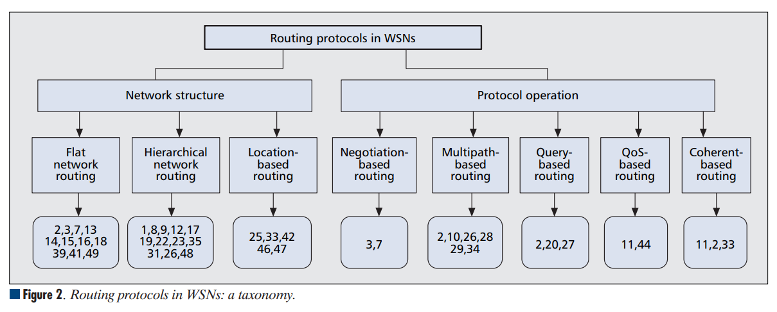
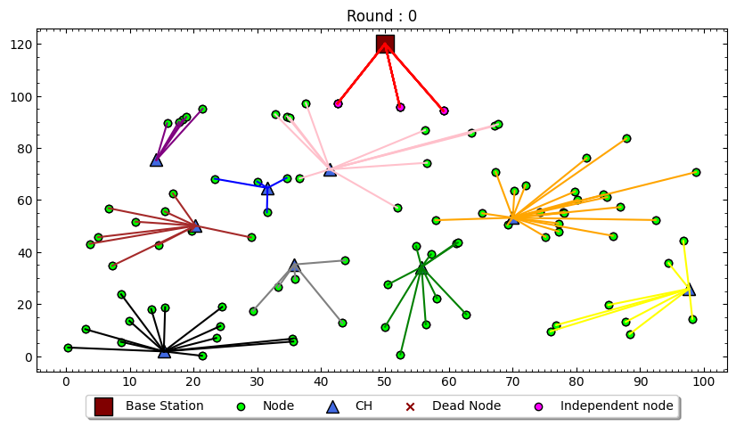
WIRELESS SENSOR NETWORK
[1]
Hierarhical based routing protocol dengan metode clustering yang paling umum digunakan adalah Low Energy Adaptive Clustering Hierarchy [3]
Hierarhical network routing memiliki keunggulan dalam hal scalability, energy efficiency dan load balancing [2].

Slide 3
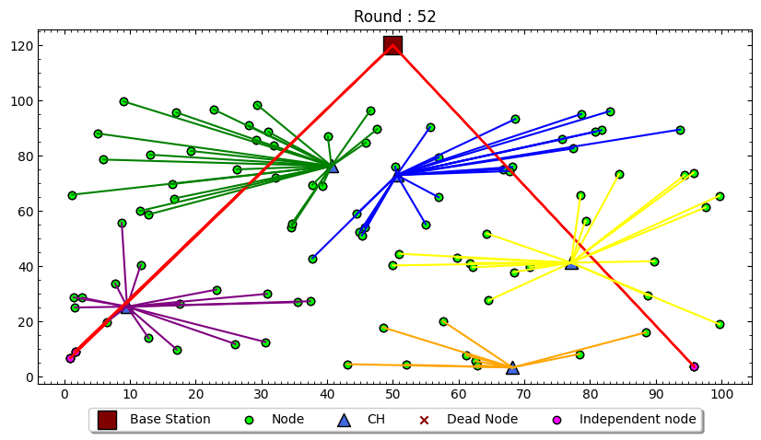
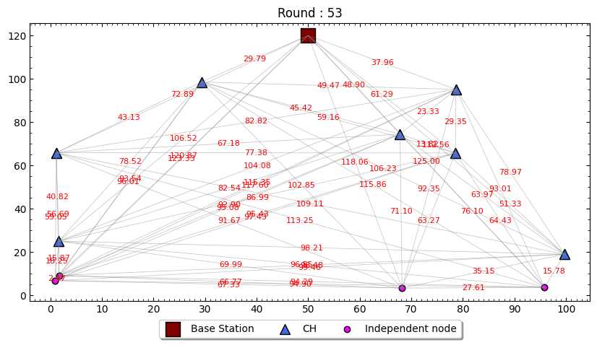
ORPHAN NODE

Slide 4
STATE OF THE ART

Slide 5
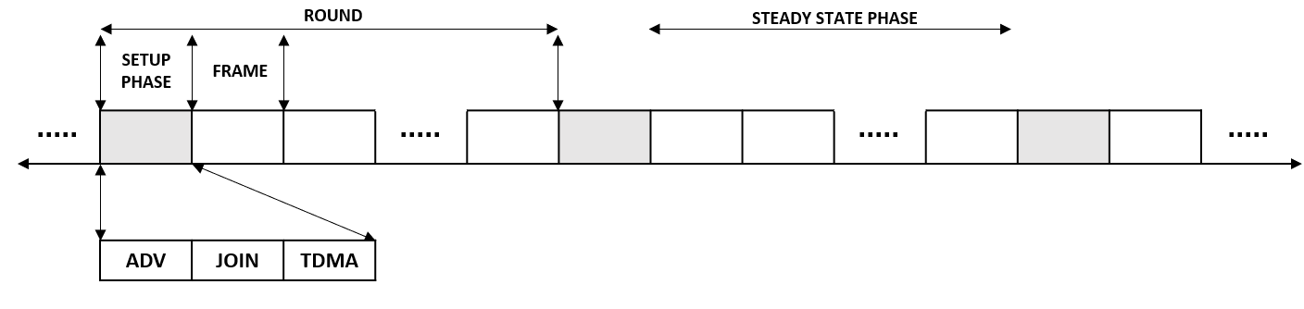
STEADY STATE

Slide 6
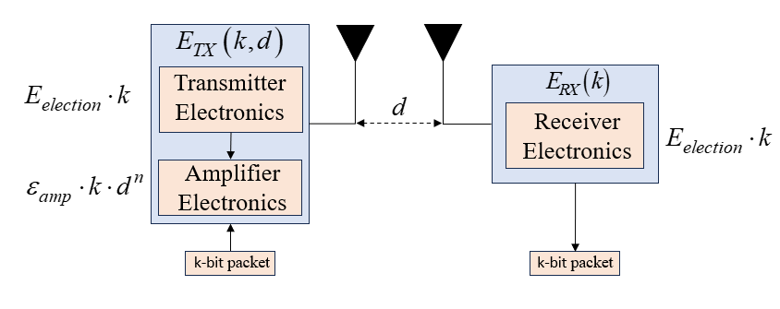
ENERGY MODEL

Slide 8
Thank you
Mirjam Nilsson​
mirjam@contoso.com
www.contoso.com

